Slide 1
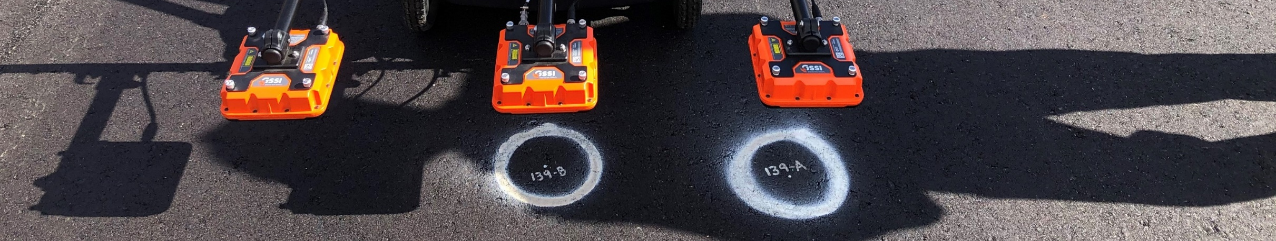
Continuous Asphalt Mixture Compaction Assessment using Density Profiling System (DPS)
Fabricio Leiva, PhD, PE
Assistant Research Professor

Slide 2
DPS Study Update
Tasks
Task 1. Pavement Thickness Effects on DPS Measurement
Task 2: Development of Equipment and Operator Certification Procedure and Analysis Methods
Task 3: Development of Precision and Bias Statement (round robin)

Slide 3
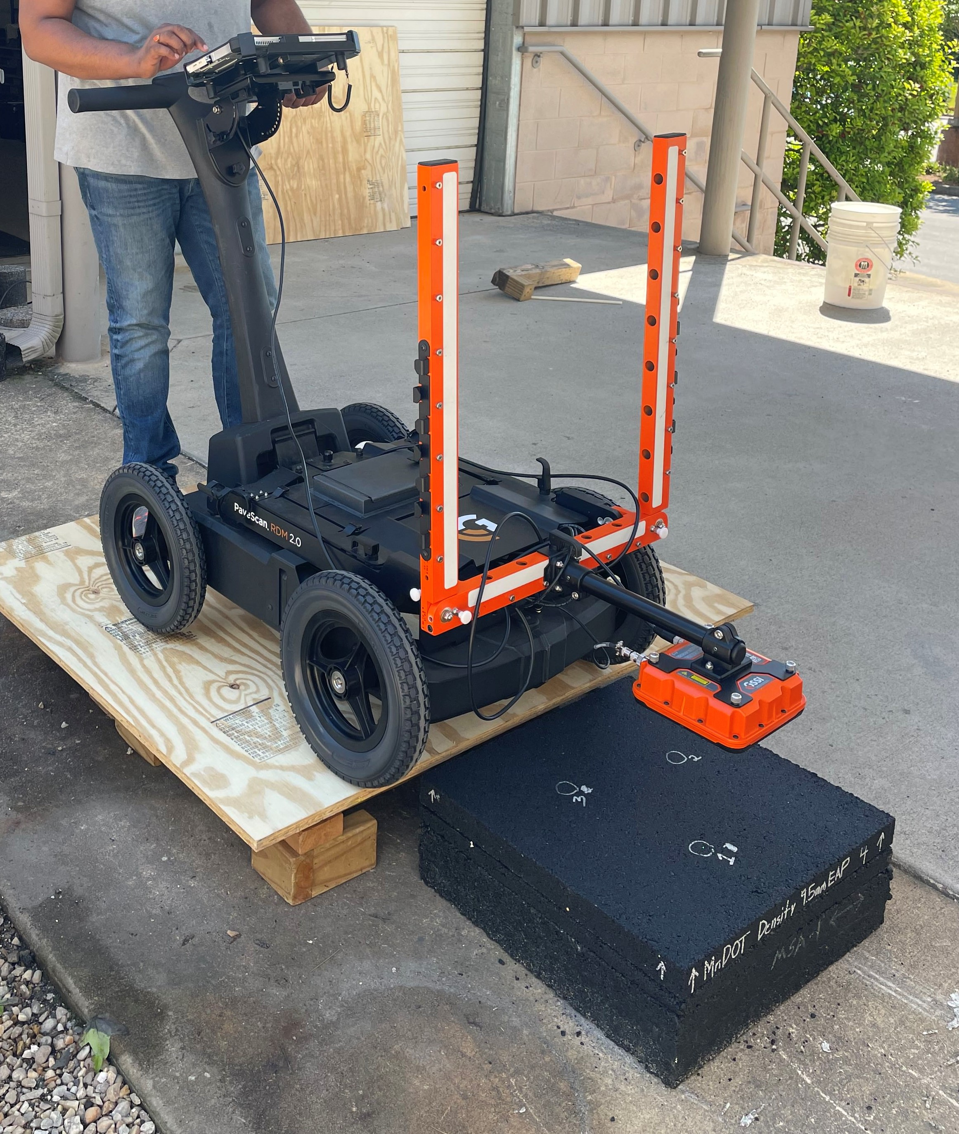
1. Pavement Thickness Effects
Asphalt Concrete (AC) slabs used:
  Originally 12 AC slabs
  Two mixtures: 9.5 & 19 mm NMAS
  Three thicknesses per mixture
GPR testing was conducted on AC slabs with:
  AC base
  Concrete floor base
  Steel plate base
Testing slab
AC Base

Slide 4
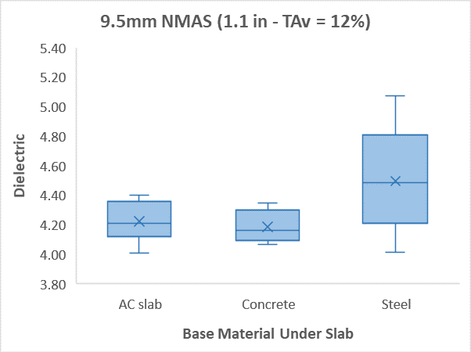
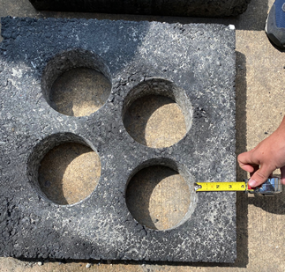
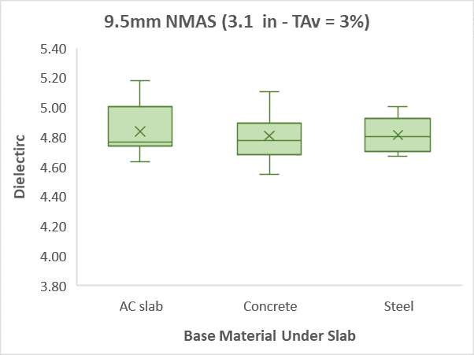
RDM test results (9.5 mm NMAS):
4 core locations per slab
3 sensors with 3 replicates in static mode
2 target Air Voids: 3% and 12%
3 thicknesses: 1, 2 and 3 inches
3 Base materials
B
A
A
Material | Dielectric
Steel | 100.0
Concrete | 6.098
AC-1 | 4.840
For thin slabs, less than 2 in., material beneath AC slab may affect readings

Slide 5
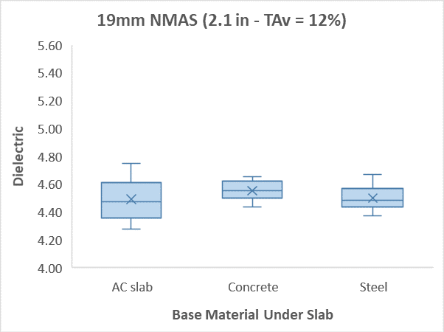
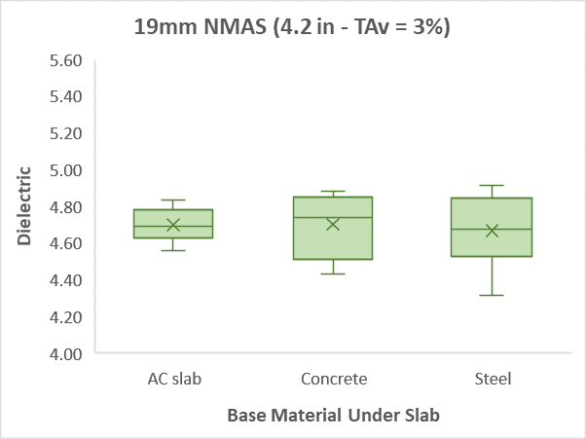
RDM test results (19 mm NMAS):
4 core locations per slab
3 sensors with 3 replicates in static mode
2 target Air Voids: 3% and 12%
3 thicknesses: 2, 3 and 4 inches
3 Base materials
Material | Dielectric
Steel | 100.0
Concrete | 6.098
AC-1 | 4.840
For slabs with thickness > 2 in., material beneath AC slab does not affect Air void results

Slide 6
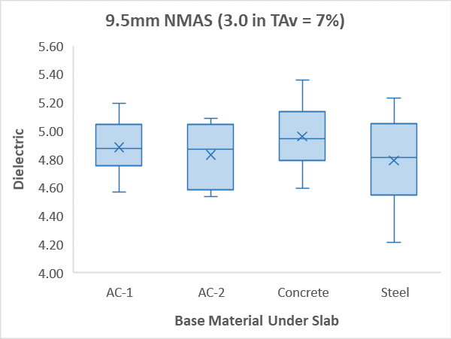
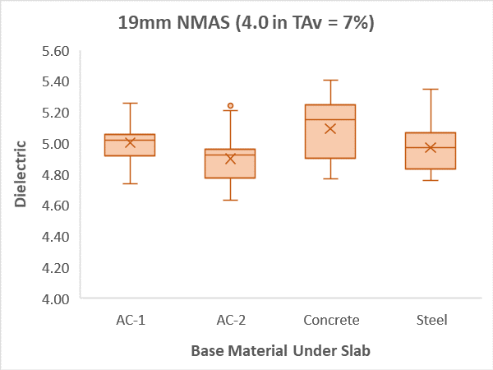
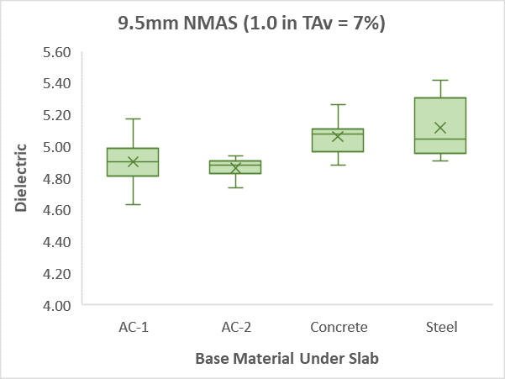
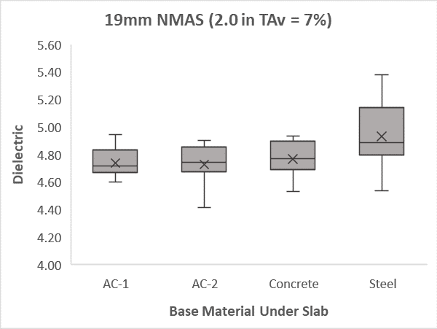
RDM test results (More slabs):
4 core locations per slab
3 sensors with 3 replicates in static mode
1 target Air Voids: 7%
2 thicknesses per mixture
4 Base materials
Material | Dielectric
Steel | 100.0
Concrete | 6.098
AC-1 | 4.840
AC-2 | 5.497
A
A
B
B
A
A
A
B
For slabs with thickness < 2 in., material beneath AC slab may affect readings

Slide 7
Action Items
Re-test all cores of first slabs
Core and test samples from second round of slabs
Prepare 4 more slabs (plastic and rubber – dry process)

Slide 8
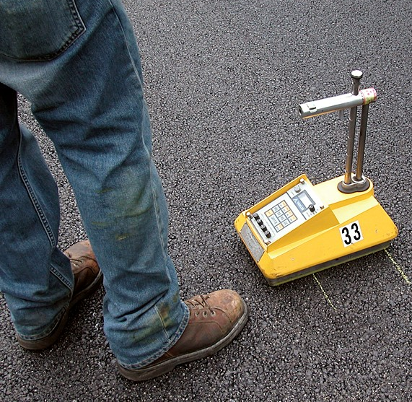
2. Density Profiler Certification Scoring System

Slide 9
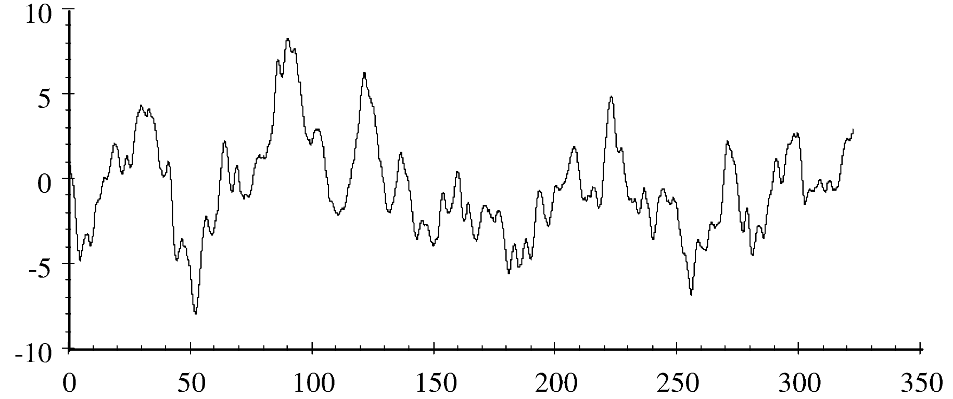
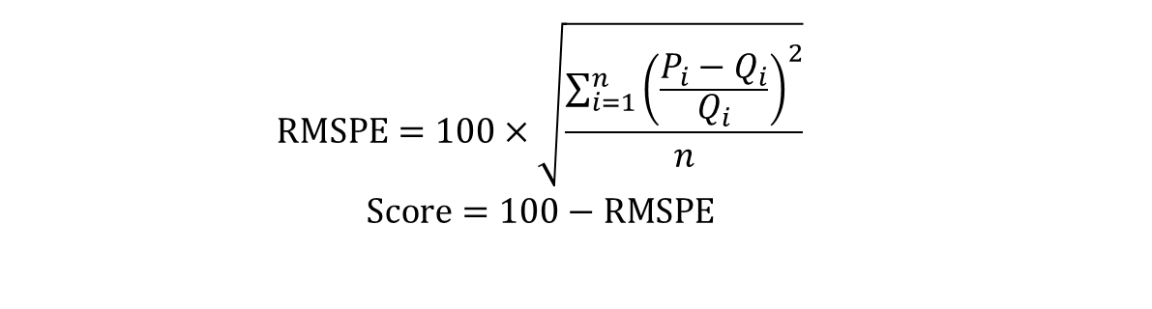
Certification Scores
Development of Accuracy and Repeatability scores similar to Inertial profilers (AASHTO R-56)
Used artificial profiles and ME modeling to evaluate the effect of profile “errors” on performance
Scores using Root Mean Square Percent Error - RMSPE (density profiles) and Mean Absolute Percent Error - MAPE (performance profiles)
Reference profile, Q
$$RMSPE=100×\sqrt{\frac{\sum_{i=1}^{n}{{\left(\frac{P_{i}−Q_{i}}{Q_{i}}\right)}^{2}}}{n}}$$
$$Score=100−RMSPE$$
Candidate profile, P

Slide 10
Density profile RMSPE:

Slide 11
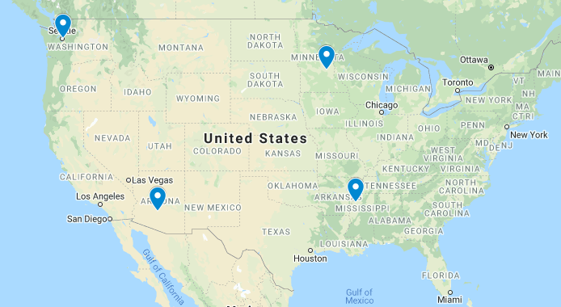



Pavement Sections (for ME modeling):
A pavement section with four layers was considered
Four climatic locations were considered
  Clarksdale, MS
  MnRoad, MN
  Seattle, WA
  Phoenix, AZ
2.0” AC
6.8” AC
6.0” A-2-4
A-6

Slide 12
Threshold Score:
Reference Profiles
Candidate Profiles
Air-void profiles are generated randomly, at every 1 ft. for 400 ft. section
  9 Reference profiles
  540 Candidate profiles per reference
Score between reference and each candidate profiles were calculated
μ | σ
4% | 0.2%
4% | 0.3%
4% | -
4% | 1.0%
4.1% | 0.2%
- | -
4.1% | 1.0%
- | -
10% | 0.2%
10% | 0.3%
10% | -
10% | -
10% | 1.0%
μ | σ
7% | 0.2%
7% | 0.3%
7% | 0.4%
7% | 0.5%
7% | 0.6%
7% | 0.7%
7% | 0.8%
7% | 0.9%
7% | 1.0%

Slide 13
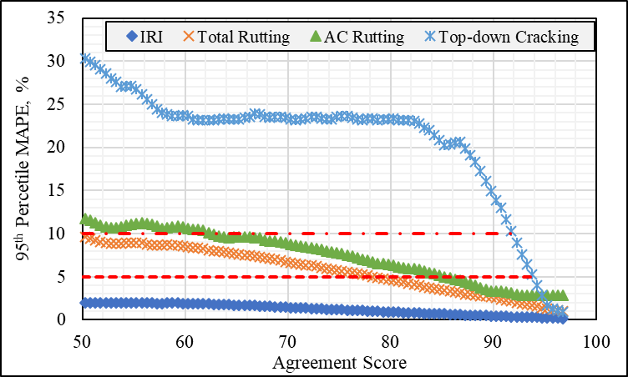
Threshold Agreement Score
Accuracy: An agreement of above 92 is required. Therefore, there will be less than 10% error in ME predicted performance in at least 95% of the comparisons used in this study.
Repeatability: An agreement of above 94 is required. Therefore, there will be less than 5% error in ME predicted performance in at least 95% of the comparisons used in this study.

Slide 14
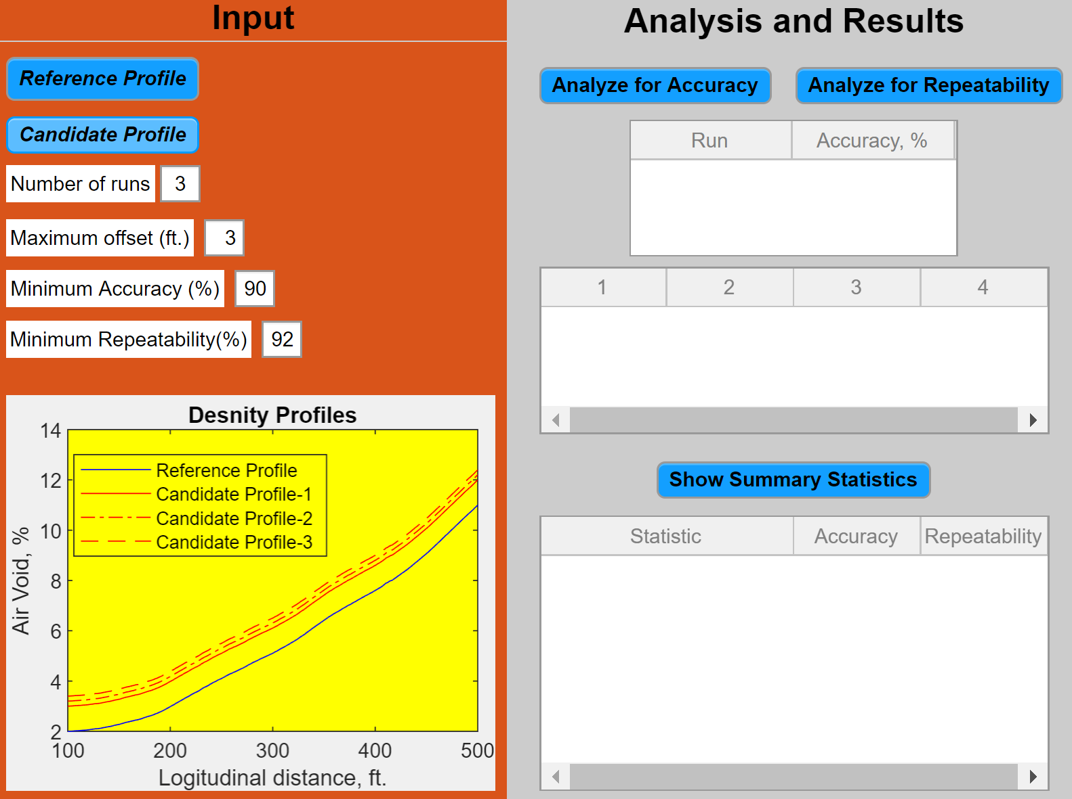
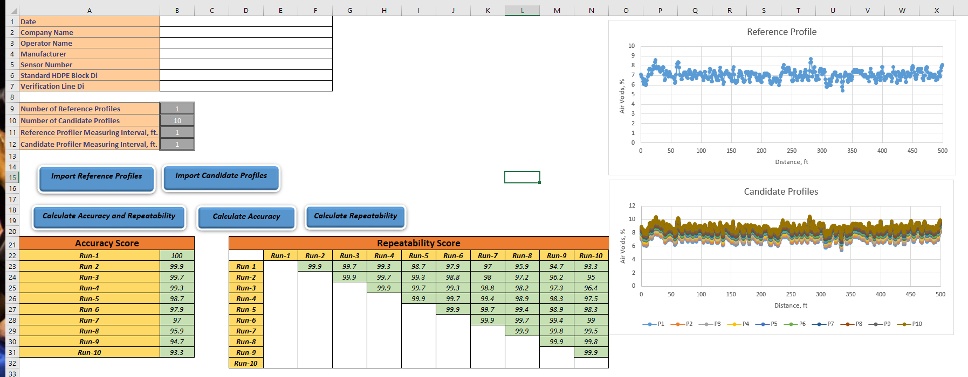
Action Items
Field verification of the proposes scores (Sections E5 and E6 at the test track with air voids ranging from 6 to 12%)
  Reference profile comes from Non-Nuclear Gauge (core corrected)
Development of Excel application

Slide 15
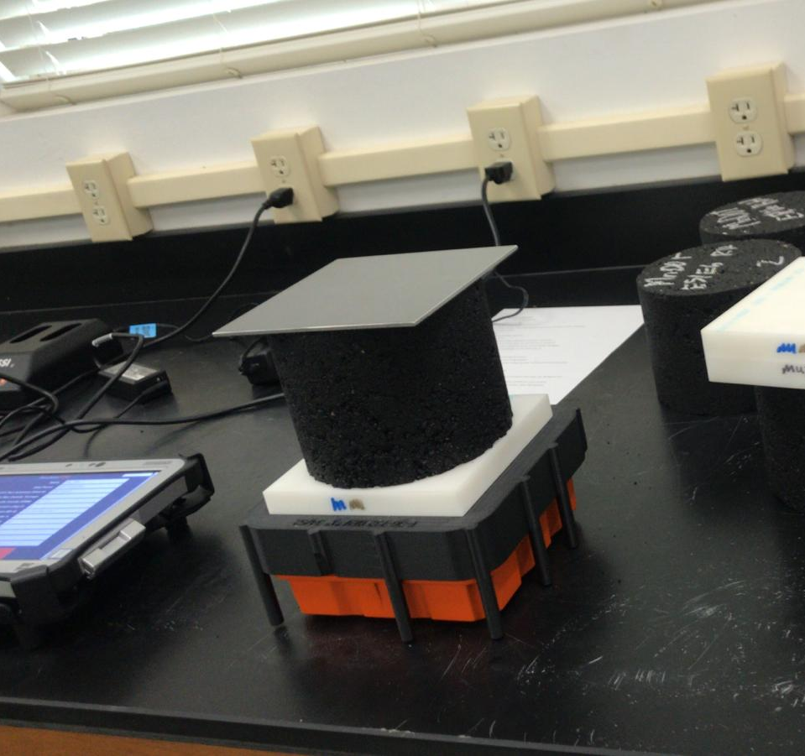
3. Precision and Bias Statement
Asphalt Concrete (AC) Pucks:
  Two mixtures: 9.5 & 19 mm NMAS
  Four air void levels: 3, 6, 9, 12%
  Three replicates per air void level
DSP testing was conducted on each puck with:
  Six different sensors (195, 206, 207, 268, 271, 273) + three operators
  At three different positions (centered, 90° rotated, flipped over)
Field Testing:
  17 Test track sections (8 for statements)

Slide 16
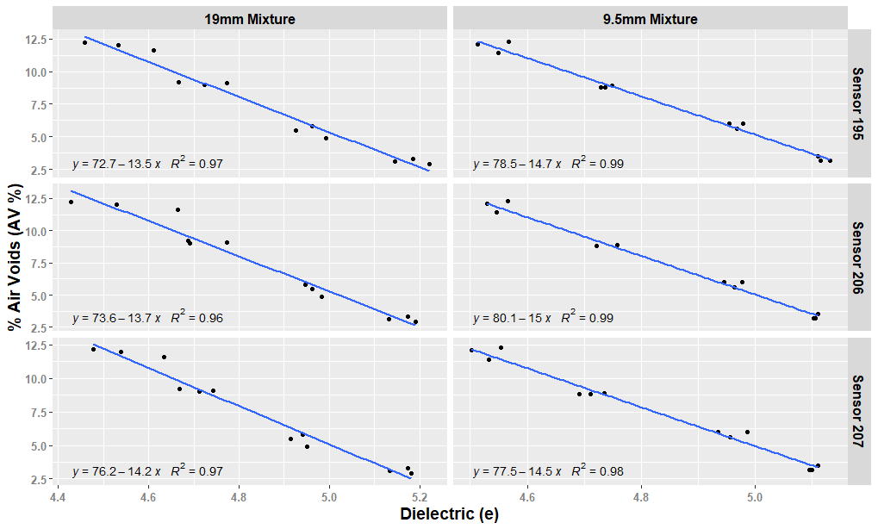
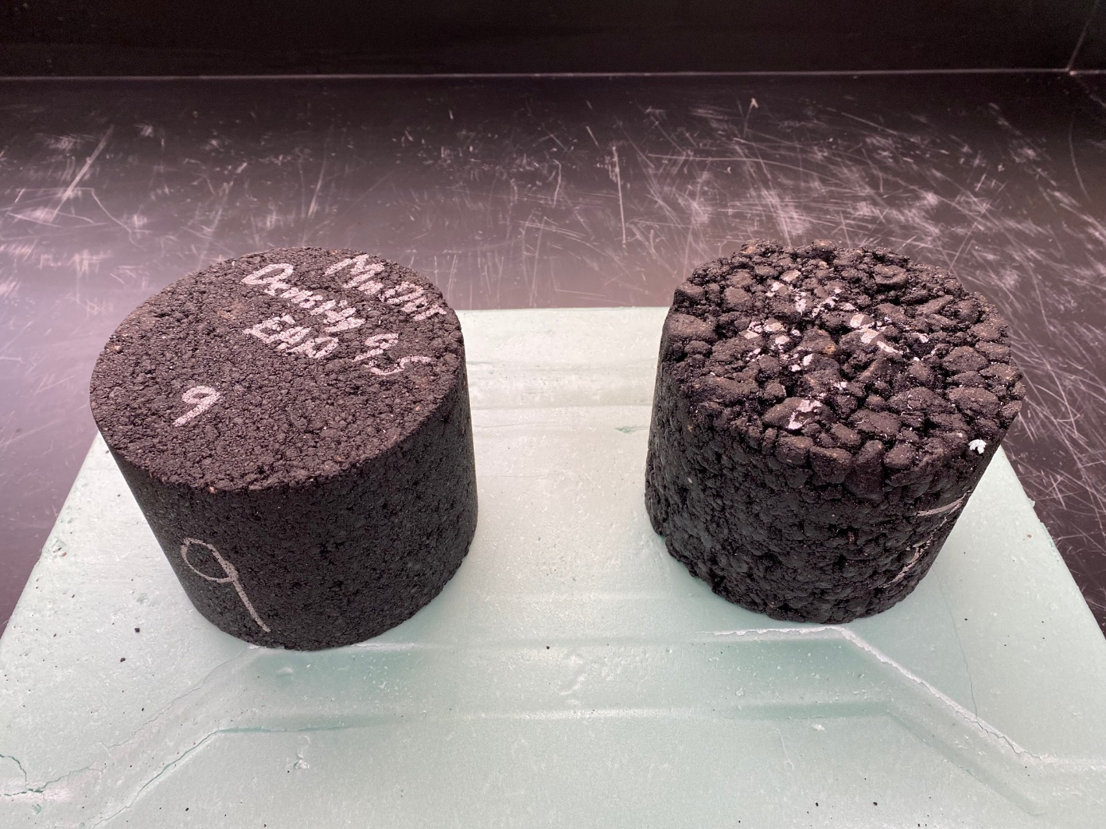
DPS Lab Calibration Results:
9.5mm
19.0mm

Slide 17
Development Process for Correlation Models
9.5mm NMAS Mixture
9.5mm NMAS Mixture
Evaluate all possible equations from different point combinations
4 AV Levels
3 AV Levels
19mm NMAS Mixture
19mm NMAS Mixture
Average Lower Limit Upper Limit
Average Lower Limit Upper Limit

Slide 18
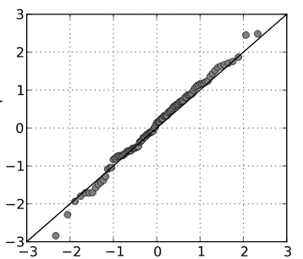
Assessment of Agreement and Concordance
Concordance Correlation Coefficient (CCC):
  Measures the agreement along the identity line.
  Product of precision by accuracy.
  Not more of 2.5% should be accepted for instruments comparison. [1]
Instrument 2
Total Deviation Index (TDI):
  Allowable boundary between paired measurements.
  Defined on terms of dielectric as 0.06.
Instrument 1
CP
Coverage Probability (CP):
  Proportion of paired observations that fall into the allowable deviation (TDI).
  Minimum coverage probability of 90% for instruments comparison. [1]
Instrument 2
Instrument 1
[1] Lin, Hedayat, A. Sinha, B. Yang, M. (2002). Statistical Methods in Assessing Agreement Models, Issues, and Tools. Journal of the American Statistical Association.

Slide 19
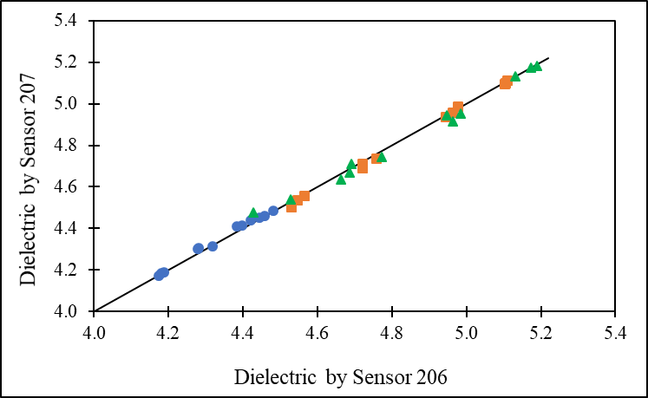
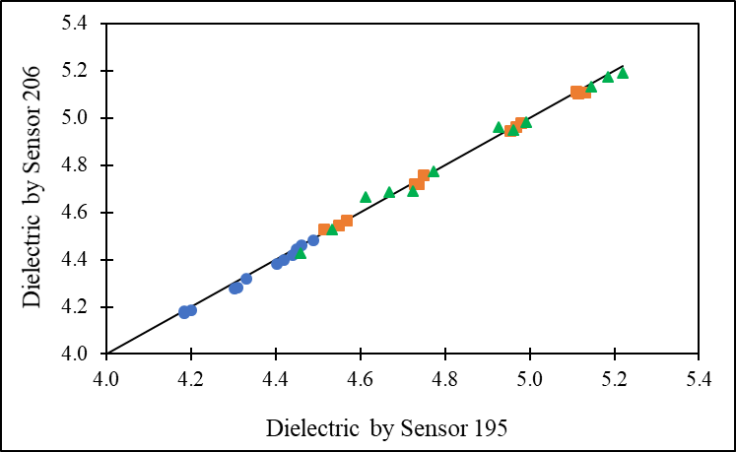

Assessment of Agreement and Concordance
Allowance and Estimated Parameters for Agreement Model (95% Confidence Level)
Sensors Compared | CCC | TDI | CP
207 vs 206 | 0.9979 | 0.0329 | 0.9968
195 vs 206 | 0.9982 | 0.0313 | 0.9982
195 vs 207 | 0.9983 | 0.0297 | 0.9960
Allowance | 0.975 | 0.06 | 0.90
It is statistically proven that the sensors can be replaced with each other
Sensor 207 and Sensor 206 Readings
Sensor 195 and Sensor 206 Readings
Sensor 195 and Sensor 207 Readings
Trial Mixture 9.5 mm Mixture 19mm Mixture

Slide 20
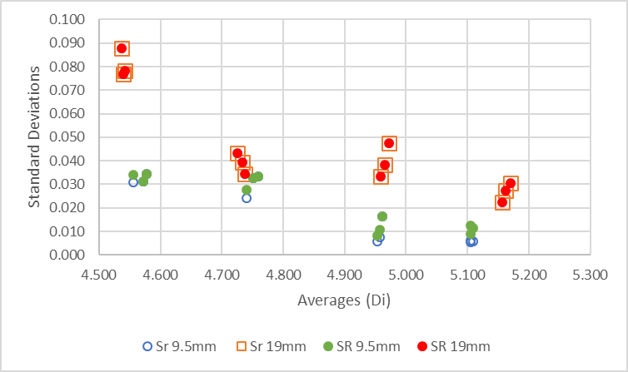
Laboratory Statements (Dielectric)
So far, 6 sensors and 3 operators
Followed ASTM E691
Met h- and k- consistency statistics
ALL the Results
 | Within Lab (r) | Between Lab (R)
Average | 0.092 | 0.096
Max | 0.246 | 0.246
Min | 0.015 | 0.023
Without High Air Void Level
 | Within Lab (r) | Between Lab (R)
Average | 0.071 | 0.074
Max | 0.133 | 0.133
Min | 0.015 | 0.023

Slide 21
Field Testing
17 sections built at the NCAT TT
Performed:
  Lab testing and correlation
  HDPE verification
  Line consistency verification
  Swerve consistency verification
  Full coverage (joint)

Slide 22
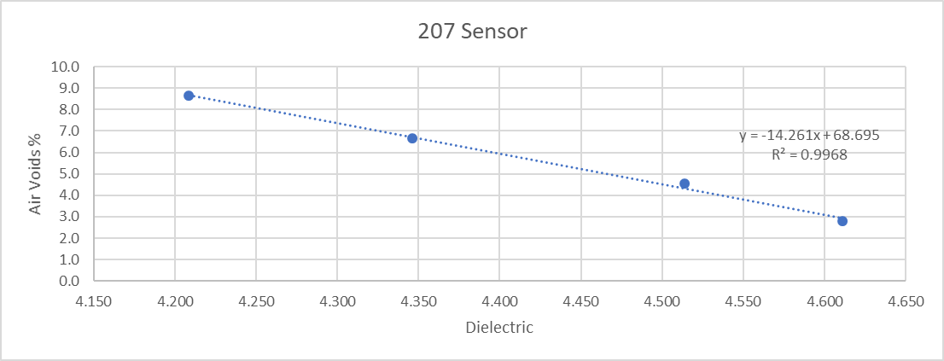
Field Testing
Lab testing and correlation
  On most cases prepared 4 samples
  Prepare medium-high air voids puck by removing between100 grs to 400 grs from
  Target field AV was 6%

Slide 23

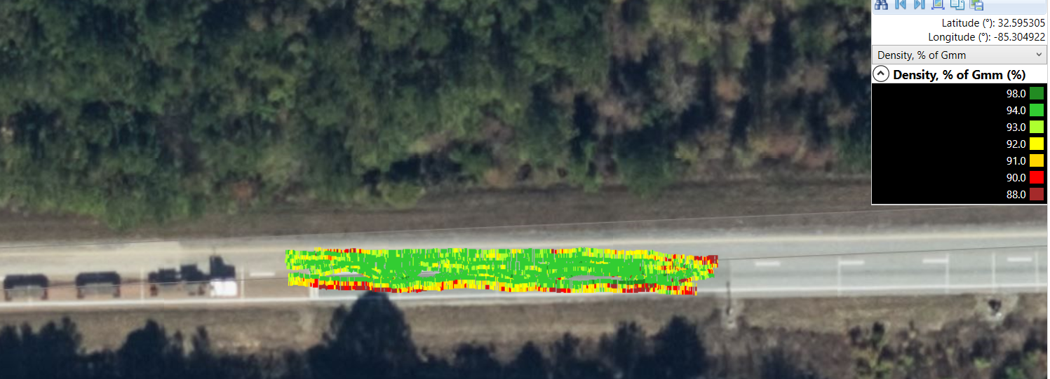

Slide 24
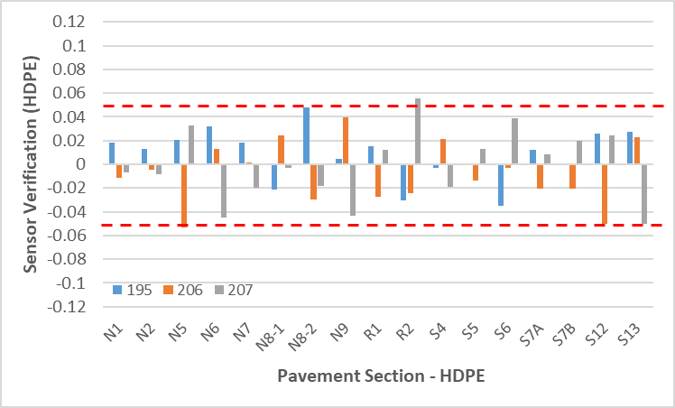
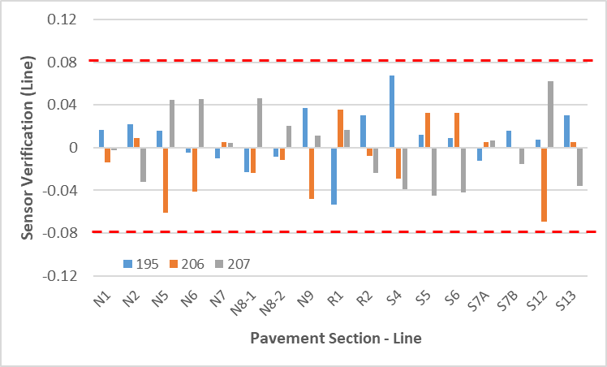
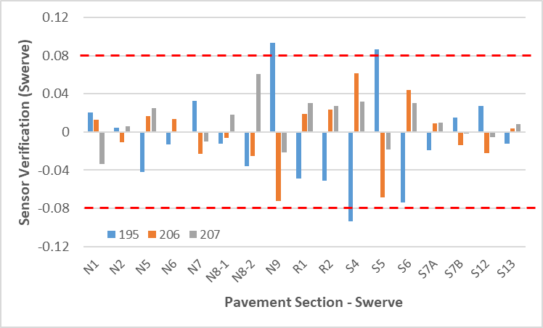
Field Consistency Verification Analysis
Line
HDPE
Swerve
Transverse Line marked on the mat (width of pavement)

Slide 25
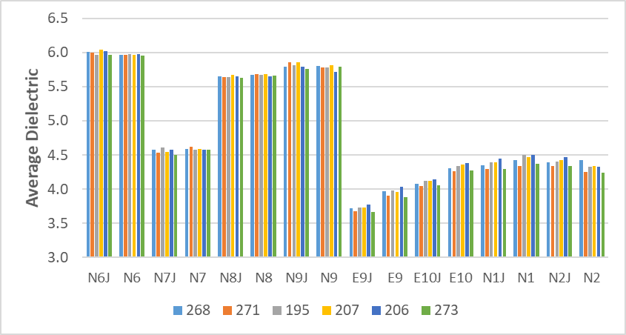
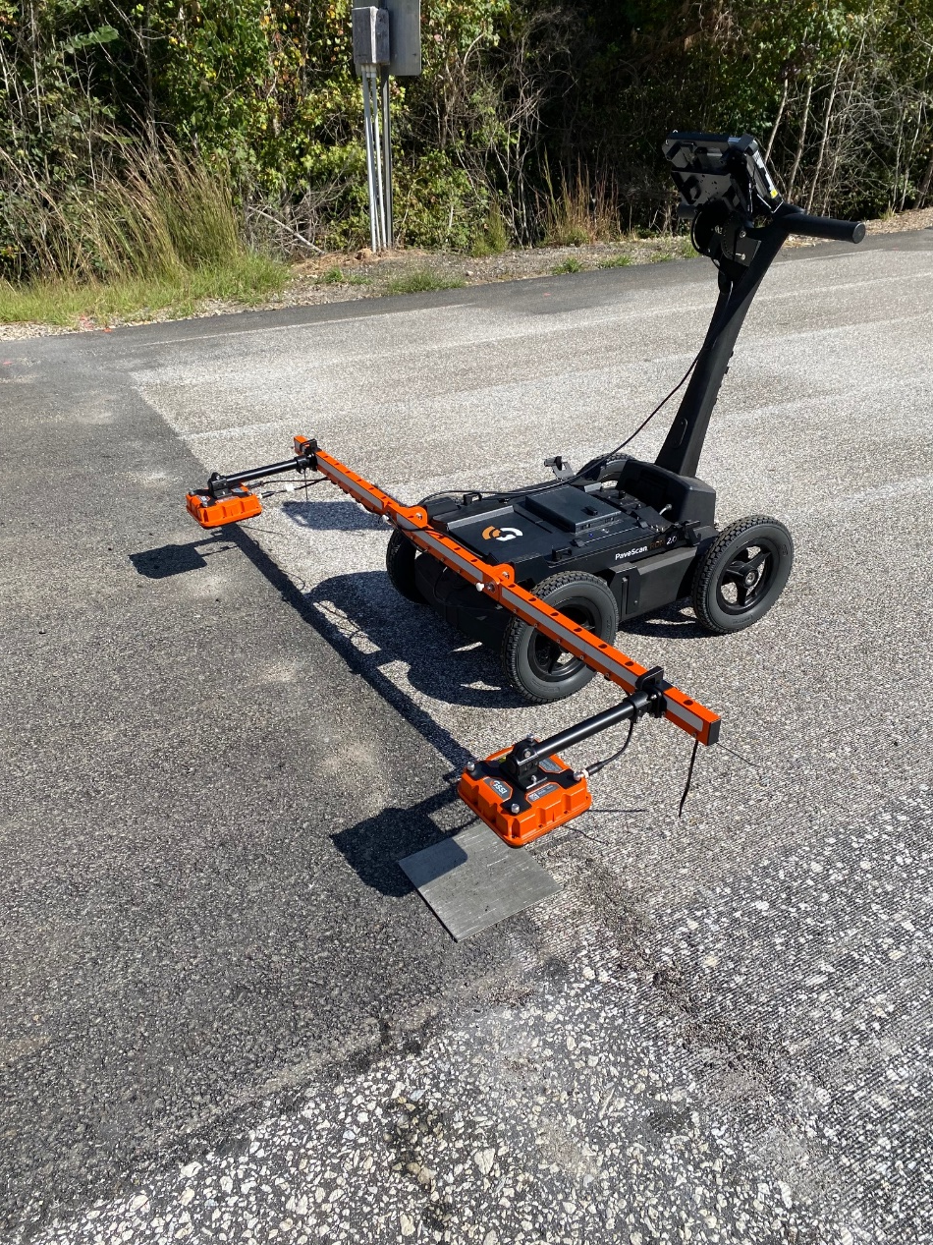
Field Statements
6 sensors, 8 sections
Joint Effect
Followed ASTM E691
Met h- and k- consistency statistics

Slide 26
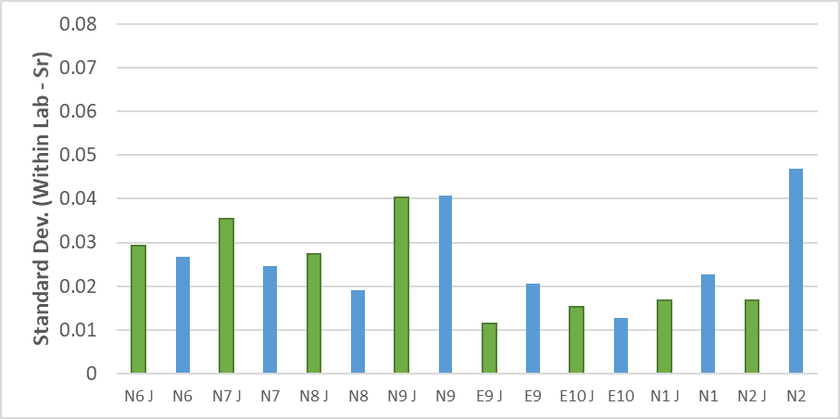
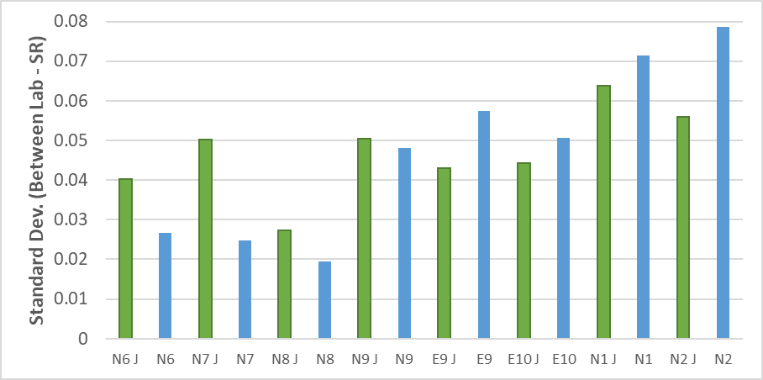
Field Statements
 | Within Lab (r) | Between Lab (R)
Average | 0.071 | 0.132
Max | 0.131 | 0.220
Min | 0.032 | 0.054
Effect of Joint results on Stan. Dev.
t-Test: Paired Two Sample on Sr: p-value 0.292
t-Test: Paired Two Sample on SR: p-value 0.486

Slide 27
Action Items
Add puck test results from MnDOT
Add more labs to the round robin?
Assessment of Agreement and Concordance to ALL sensors
Update lab correlation curves with core results
Analysis of Full coverage vs. Swerve

Slide 28
Project Schedule
Submit task 2 for review December 2021
  Draft AASHTO Standard and partial report
Submit task 1 partial report for review January 2022
Submit task 3 partial report March 2022
Address a comments/edits and submit final report May 2022

Slide 29
Preliminary conclusions
Dielectric values of thin lifts (< 2 in) may be affected by the base materials with significantly higher Di values compared to asphalt concrete
Preliminary Certification Scores (from modeled results) are: 92% accuracy and 94% repeatability
For development of lab correlation equations, maximum 10% AV is recommended

Slide 30
Preliminary conclusions
Agreement and Concordance evaluations have indicated that sensors used in this study can be replaced with each other when testing in the lab
Line consistency verification may provide more confidence on the quality of the sensors for personnel with less experience
No effect on field statements for measurements near the joint has been obtained with the equipment used in this study

Slide 31
leivafa@auburn.edu

